Slide 1
ARTIS for spectral interpretation

Slide 2
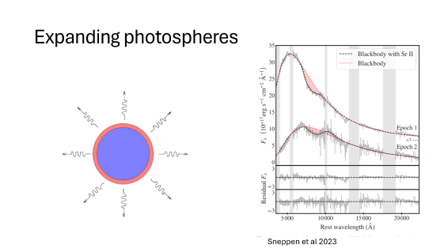
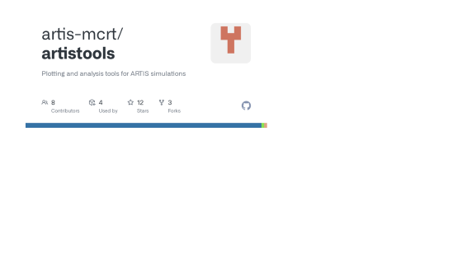
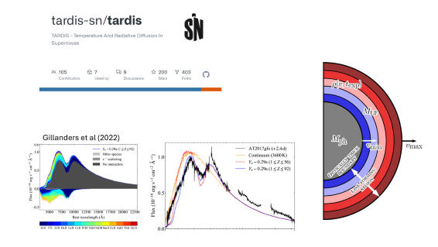
Interpretability
Realism

Slide 3
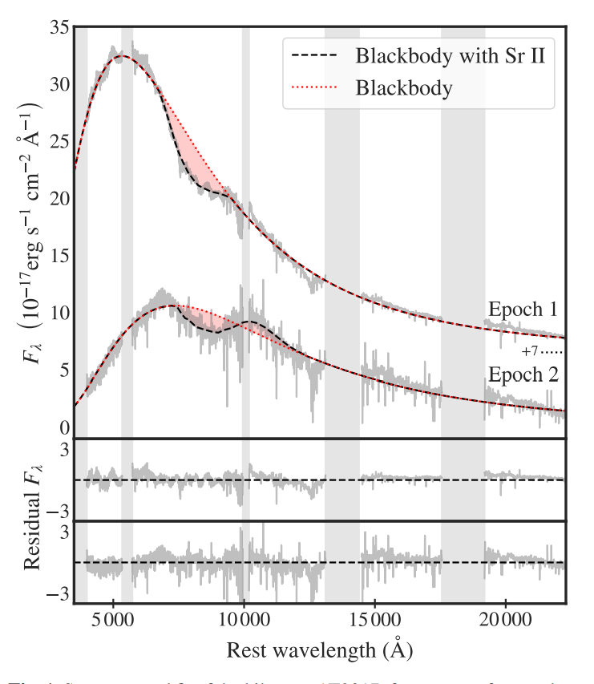
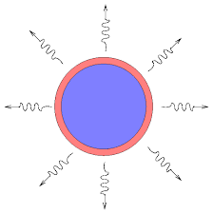
Expanding photospheres
Sneppen et al 2023

Slide 4
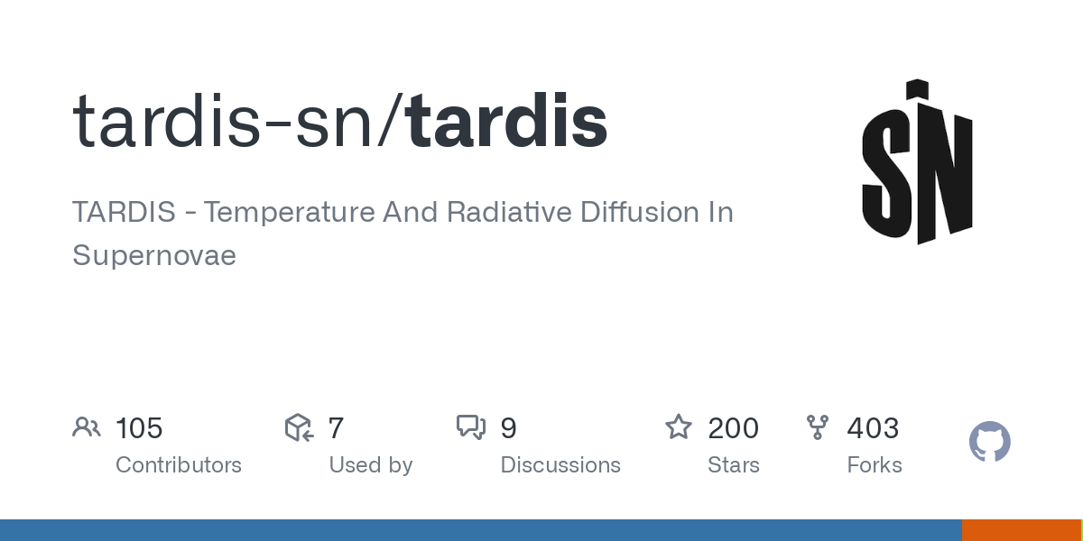
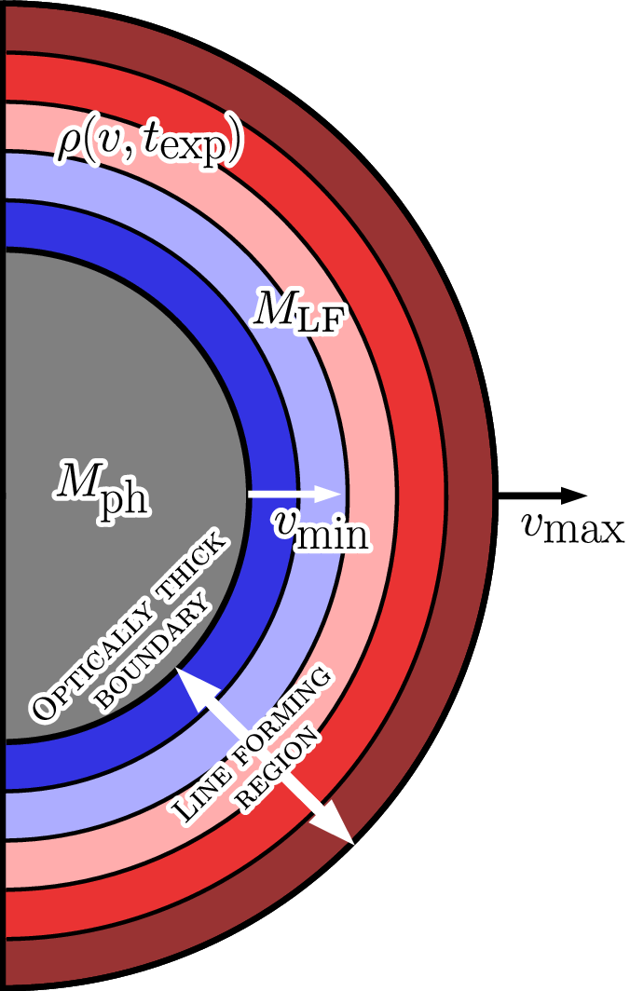
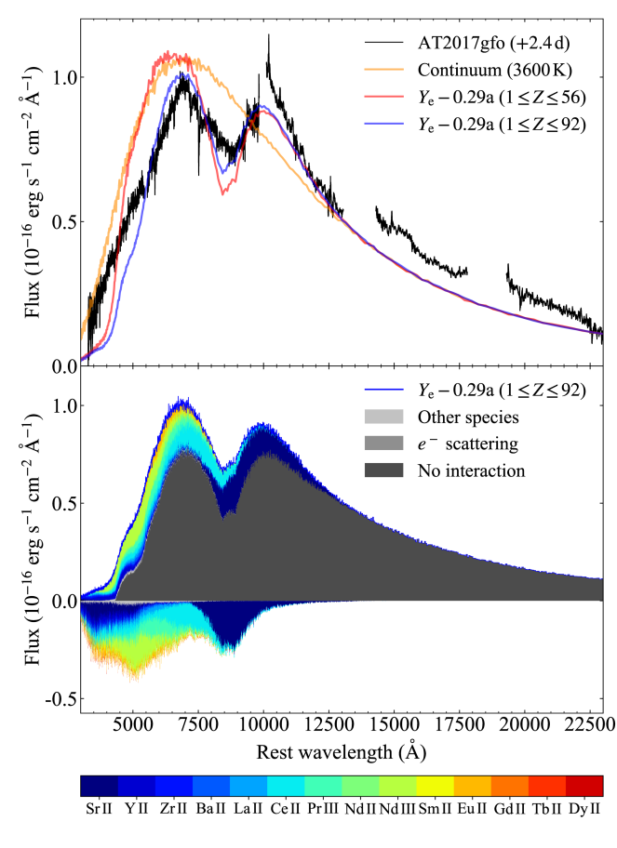
Gillanders et al (2022)

Slide 5
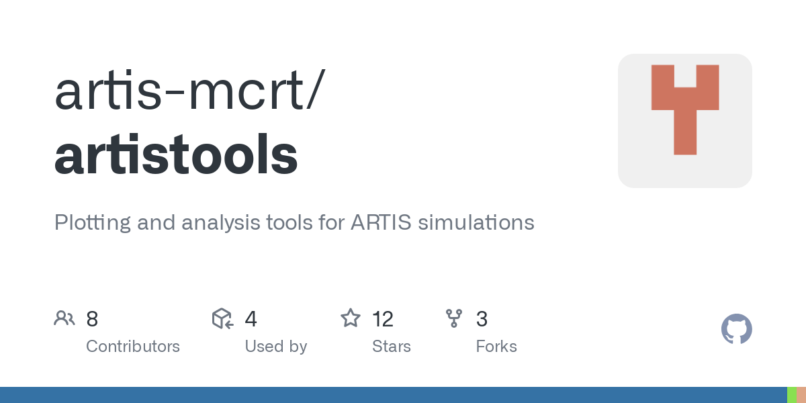

Slide 6
Private correspondence with Luke

Slide 7
Private correspondence with Luke

Slide 8
Gameplan:
Will explore:
Analytical 1d mass profiles
Selected Ye distributions
Artificial high-density opacity
Inputs very welcome!

